Slide 1
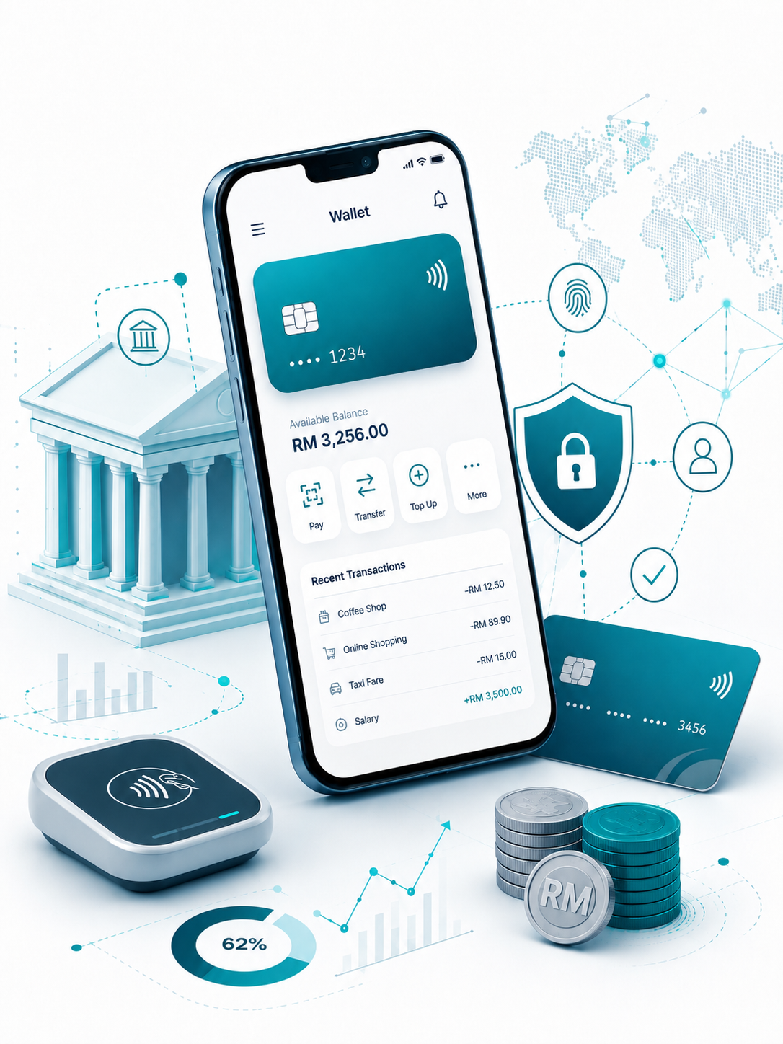

Insert relevant picture related to the topic
TFB3323 FINTECH INNOVATION
WEEK V
DIGITAL-ONLY BANKS
Shuhaida Bt M Shuhidan
(Dr (FSMC/UTP))
BACHELOR OF XXXXXX
DEPARTMENT OF COMPUTING
FACULTY OF SCIENCE, MANAGEMENT & COMPUTING
© 2026 INSTITUTE OF TECHNOLOGY PETRONAS SDN BHD
All rights reserved. No part of this document may be reproduced, stored in a retrieval system or transmitted in any form or by any means (electronic, mechanical, photocopying, recording or otherwise) without the permission of the copyright owner.

Slide 2
RECAP FROM PREVIOUS LECTURE
Phones are the New Banks: Mobile phones act like a bank branch right in your pocket. Most people use them to easily check their balances, send money, or pay bills.
Apps Must Be Great: A banking app has to be very easy to use, highly secure, and offer personalized choices. Tech startups and big tech companies, rather than traditional banks, now set the standard for what makes a great user experience.
Big Savings & Loyal Customers: It costs a bank only $0.10 for a mobile visit compared to $4.25 for a physical branch visit. Also, users who bank on their phones stay with the bank longer and make more transactions, which brings in more money.
The Hard Parts: The biggest hurdles are keeping the apps safe from security threats on personal devices and trying to connect fresh mobile apps to outdated bank computer systems.
Banks are Changing: To keep up, old banks are moving their core systems to the cloud. They are also turning into "platforms" that allow third-party apps to connect with them so they can offer better services to users.
Notes:
Learning Outcomes Slide
Note:
Include 2–4 lecture-level learning outcomes
Use measurable action verbs
Map explicitly to Course Learning Outcomes (CLOs)

Slide 3
LEARNING OUTCOMES
By the end of this session, students will be able to:
Differentiate Bank Types: Distinguish between "Neobanks" (no full banking license) and "Challenger Banks" (full banking license).
Analyze Value Propositions: Understand how digital banks use lower operational costs—from avoiding branches and legacy IT—to offer lower fees, higher rates, and better customer experiences.
Evaluate Profitability Strategies: Recognize the challenge of moving from rapid customer acquisition to sustainable profit, often by shifting to lending or paid subscription tiers.
Identify Risks and Regulations: Assess core sector risks like cybersecurity and data protection, alongside what regulators require, such as consumer protection and a clear path to profit.
Understand Incumbent Responses: Learn how traditional banks compete by launching parallel digital brands, acquiring neobanks, or forming strategic partnerships.
Notes:
Learning Outcomes Slide
Note:
Include 2–4 lecture-level learning outcomes
Use measurable action verbs
Map explicitly to Course Learning Outcomes (CLOs)

Slide 4
TOPICS
Introduction to Digital-only Banks?
1.1. Types of Digital Challenger Banks (Neobanks vs. Challenger Banks)
1.2. Key Prerequisites for Digital Banking
1.3. Example Banks and General Strengths
2. Value Proposition: How Neobanks Do It?
2.1. Lower Operation Costs and Fees?
2.2. Faster Product Launches and Technology Utilization
2.3. Better Customer Experience (CX) and Personalization
2.4. Open Ecosystems, Transparency, and Security
Strategic Priorities and Market Demands
3.1. What Banking Customers Want
3.2. Attracting Customers and Differentiation
3.3. Expanding Profitably
3.4. Strategic Partnerships and Social Network Use
Issues, Risks, and Challenges
4.1. Consumer Protection and Regulatory Risks
4.2. Cybersecurity and Data Protection
4.3. The Hurdle of Profitability and Business Sustainability
Notes:
Engagement and Activity Slides
Note:
Include at least one engagement element where appropriate:
Think–Pair–Share
Mini task
Poll or reflection question
Suggested duration: 3–5 minutes
Activities shall align with learning outcomes

Slide 5
TOPICS
Case Studies and Global Trends?
5.1. SME Adoption of FinTech
5.2. Regional Developments (Malaysia and Singapore)
5.3. Global Growth of Challenger Banks in 2022
Strategies for Incumbent Banks
6.1. Acquisitions and Tech Investments
6.2. In-house Builds and Parallel Brands
6.3. Partnering with FinTechs
Regulations and Suitability
7.1. Regulators' Goals (Competition and Financial Inclusion)
7.2. Key Factors for Assessment (Profitability, Differentiation, Consumer Protection)
Conclusion and Future Outlook
8.1. Rebundling Services via Open Banking
8.2. Market Consolidation
8.3. Disruptive Innovation vs. Incremental Improvement
8.4. Adding Genuine Value and Live Support
Notes:
Engagement and Activity Slides
Note:
Include at least one engagement element where appropriate:
Think–Pair–Share
Mini task
Poll or reflection question
Suggested duration: 3–5 minutes
Activities shall align with learning outcomes

Slide 6
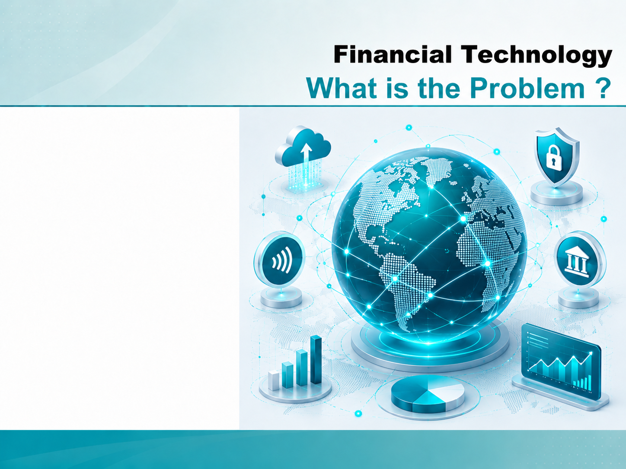
FINTECH
Digital-only Banks

Slide 7
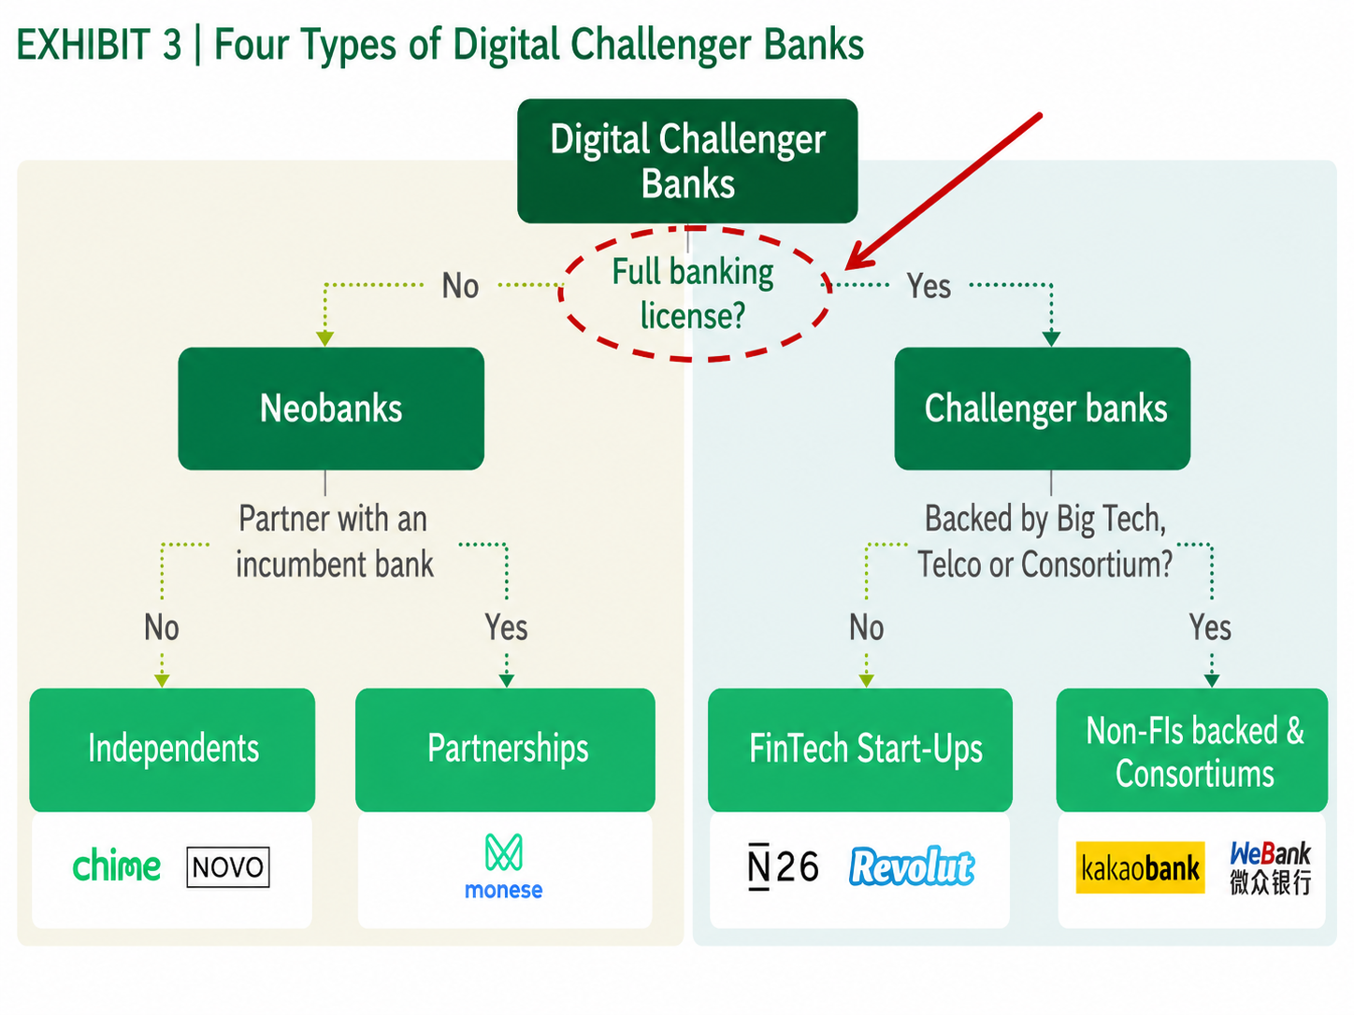
Types of Digital Challenger Banks
Notes:
Engagement and Activity Slides
Note:
Include at least one engagement element where appropriate:
Think–Pair–Share
Mini task
Poll or reflection question
Suggested duration: 3–5 minutes
Activities shall align with learning outcomes

Slide 8
Financial Technology – Digital-only Banks (Neobanks)
1.1. Generally : Challenger Banks
Many of these banks’ distinctive offerings mean they do not need to compete directly with the main high street banks to succeed. They do not aspire to replace the main high street banks or in many cases even to challenge them directly; rather they aim to meet customer needs not currently being well-served.
Emerging Digital-only Banks can be broadly slotted into two main categories — those with, and those without, a full banking license.
Those institutions without full banking licenses are categorized as Neobanks. Those with a full banking license are identified as Challenger Banks
Notes:
Engagement and Activity Slides
Note:
Include at least one engagement element where appropriate:
Think–Pair–Share
Mini task
Poll or reflection question
Suggested duration: 3–5 minutes
Activities shall align with learning outcomes

Slide 9
Digital-only Banks
Consumers', particularly millennials', growing frustration with legacy banking service providers, combined with their increased appetite for digital solutions, has accelerated the shift to digital-only banking.
These digital-only banks are clear on who they are targeting:…. a growing segment of digitally literate customers who want simplicity, transparency and useful services. These customers tend to be younger, as consumer research revealed with 39% of British 18- 24 year olds viewing a bank’s mobile app as essential when opening a current account, compared to only 13% of those aged over 55.
These banks understand the trend towards Open Banking and are actively designing the role they will play in this future environment. They are also conscious of the need for their segment to establish credibility – a single failure would damage confidence in them all.
Notes:
Engagement and Activity Slides
Note:
Include at least one engagement element where appropriate:
Think–Pair–Share
Mini task
Poll or reflection question
Suggested duration: 3–5 minutes
Activities shall align with learning outcomes

Slide 10
Digital-only Banks
The digital-only banks are all fresh, technology-driven start-ups. Like other exciting new digital ventures they have been able to attract highly skilled and motivated talent. They are visionary and ambitious, actively re-imagining how banking could be radically transformed. They are nimble (agile) with their relatively small size and willingness to change ensuring they have the ability to keep innovating and adapting.
These banks have modern, state of the art technology platforms, either developed in-house or using the latest software from well-established and credible banking system vendors. Such platforms offer differentiating functionality in a user-friendly way, deployed for use on modern devices, and particularly through mobile channels.
Notes:
Engagement and Activity Slides
Note:
Include at least one engagement element where appropriate:
Think–Pair–Share
Mini task
Poll or reflection question
Suggested duration: 3–5 minutes
Activities shall align with learning outcomes

Slide 11
Digital-only Banks
They are designed to be scalable, so that the banks can grow volumes rapidly without an adverse impact on performance and ensuring that the cost-of-service provision remains reasonable for the size of the business. They are also typically built in a modular way, positioning the banks to take advantage of the Open Banking trend by readily integrating functionality and data from other sources.
Digital-only banks recognise the megatrend of customers shifting to digital channels and are building their business to serve both digital natives and converts. They pride themselves on innovative technology platforms that promise exceptional customer experience and engagement, primarily through mobile apps.
The majority have been founded very recently, and are launching in different ways:
- Starling intends to offer a current account;
Monzo has launched with a pre-paid card;
Atom (UK, mobile-only) is starting with a fixed-term
savings account
Notes:
Engagement and Activity Slides
Note:
Include at least one engagement element where appropriate:
Think–Pair–Share
Mini task
Poll or reflection question
Suggested duration: 3–5 minutes
Activities shall align with learning outcomes

Slide 12


Digital-only Banks
Example Banks
Revolut (UK) Monzo (UK) Starling (UK) Tandem (UK)
Number26 (Germany) Nubank (Brazil) Anytime (France)
Proposition
Initially limited retail product offering, focused on digitally savvy customers
No Physical Presence
Growing and start to be profitability
Notes:
Engagement and Activity Slides
Note:
Include at least one engagement element where appropriate:
Think–Pair–Share
Mini task
Poll or reflection question
Suggested duration: 3–5 minutes
Activities shall align with learning outcomes

Slide 13
Digital-only Banks
Strengths
Modern platforms and apps
Scalable models
Strong online communities
Strategies for Success
Attract customers and build trust
Differentiate from other digital players
Take advantage of Open Banking and Innovate
Expand profitably
Notes:
Engagement and Activity Slides
Note:
Include at least one engagement element where appropriate:
Think–Pair–Share
Mini task
Poll or reflection question
Suggested duration: 3–5 minutes
Activities shall align with learning outcomes

Slide 14
Digital-only Banks
Digital-only challenger banks, often referred to as neobanks, broke into the market a few years ago in response to the rising demand for simple, quick and hassle-free online and mobile services.
Their appeal to users lies in their ability to challenge traditional banks’ old-school business model by charging customers low and transparent fees, while offering faster services and a better user experience
Regulatory authorities in Australia, Japan, Hong Kong and Taiwan have already issued virtual bank licenses while Singapore and Malaysia are looking to catch up.
The Monetary Authority of Singapore received 21 applicants competing for five virtual banking licenses.
Notes:
Engagement and Activity Slides
Note:
Include at least one engagement element where appropriate:
Think–Pair–Share
Mini task
Poll or reflection question
Suggested duration: 3–5 minutes
Activities shall align with learning outcomes

Slide 15
DIGITAL-ONLY BANKS
Strategic
Priorities

Slide 16
How Neobanks Do It
1.1. LOWER OPERATION COSTS
With no branches or extensive legacy IT systems to maintain, digital-only startups can run with relatively low operation costs.They automate functions and use cloud-based infrastructure instead of on-premise systems, which also contributes to favourable servicing costs that can be 40-70% lower than the expenses of mainstream banks.
1.1. EASY SETUP
Easy setup – Creating an account with a challenger bank is a paperless and straightforward process. Most accounts can be set up entirely from a mobile device as well
Notes:
Engagement and Activity Slides
Note:
Include at least one engagement element where appropriate:
Think–Pair–Share
Mini task
Poll or reflection question
Suggested duration: 3–5 minutes
Activities shall align with learning outcomes

Slide 17
How Neobanks Do It
1.1. LOWER FEES, HIGHER RATES
Neobanks usually charge their customers low or no fees and provide higher-than-average interest rates on savings thanks to their lower operation costs. Getting better rates and free transactions abroad are among the top five most important reasons why people switch to digital- only players (according to 31% and 22% of customers, respectively).
Lower fees – With fewer operational costs, challenger banks can price their services more competitively.
Notes:
Engagement and Activity Slides
Note:
Include at least one engagement element where appropriate:
Think–Pair–Share
Mini task
Poll or reflection question
Suggested duration: 3–5 minutes
Activities shall align with learning outcomes

Slide 18
How Neobanks Do It
1.1. FASTER PRODUCT LAUNCHES
Neobanks Digital-only players have been largely relying on partnerships and teaming up with third-party companies to bring various products and customer solutions to market as quickly as possible. These partnerships, often developed into entire digital ecosystems or marketplaces, help neobanks save time and money and be able to react to changing customer demand in a more flexible way.
Added Features – In addition to providing digital banking accounts, many challenger banking apps offer their customers built-in payment, budgeting, and savings tools.
Notes:
Engagement and Activity Slides
Note:
Include at least one engagement element where appropriate:
Think–Pair–Share
Mini task
Poll or reflection question
Suggested duration: 3–5 minutes
Activities shall align with learning outcomes

Slide 19
How Neobanks Do It
1.1. LEVERAGING TECHNOLOGY
Neobanks What prevents many traditional banks from following the strategy of neobanks is that they still operate multiple decades-old legacy systems. Banks spend about 70% of their IT budgets on traditional IT services, like maintaining core systems, and only about 30% on non-traditional solutions related to digital transformation, such as cloud and data analytics.
New players utilize modular technology design, advanced analytics, and agile governance, providing a service which can rapidly respond and scale as demands change. Cloud-native focus, open architecture, and data-driven processes all complement this approach
Notes:
Engagement and Activity Slides
Note:
Include at least one engagement element where appropriate:
Think–Pair–Share
Mini task
Poll or reflection question
Suggested duration: 3–5 minutes
Activities shall align with learning outcomes

Slide 20
How Neobanks Do It
1.1. LOWER RISK AVERSION
Neobanks Incumbents also tend to be more risk-averse when it comes to offering innovative digital services and are often held back by their own conservative approaches.
Neobanks → seem less afraid of experimenting and learning from their failures. They are not limited by lengthy bureaucratic procedures and are more likely to talk to their customers about their needs before launching any new products.
Notes:
Engagement and Activity Slides
Note:
Include at least one engagement element where appropriate:
Think–Pair–Share
Mini task
Poll or reflection question
Suggested duration: 3–5 minutes
Activities shall align with learning outcomes

Slide 21
How Neobanks Do It
1.1. BETTER CUSTOMER EXPERIENCE (CX)
Digital-only challengers have certainly raised the bar in satisfying customer needs by offering fast, seamless and personalised services. They respond to feedback by adding features users love, like real-time balances, transaction alerts, budgeting tools and personal finance solutions.
Putting a bigger focus on user and customer experience also explains why neobanks’ satisfaction ratings (76%) exceed that of the top 50 global banks (69%) in the UK, the US (83% vs 67%) and Germany (82% vs 60%)
Notes:
Engagement and Activity Slides
Note:
Include at least one engagement element where appropriate:
Think–Pair–Share
Mini task
Poll or reflection question
Suggested duration: 3–5 minutes
Activities shall align with learning outcomes

Slide 22
How Neobanks Do It
Product design and UX (user experience) are just one –albeit important – and makes up your company’s value proposition, but the overall CX (customer experience) is dependent on a much wider array of factors.
How quickly can customers move and access money?
How predictable and stable are your services?
How do you balance risk and compliance with introducing friction in your customer journey?
Do customers have access to live support when they need it?
Are customers’ data and money safe and secure?
How well your company does on these fronts has much more impact on customers’ satisfaction than the frontend.
Notes:
Summary and Closure Slides
Note:
Summarise 3–5 key takeaways
Reinforce main ideas
Indicate CLO coverage where appropriate
Include:
Upcoming topics
Required reading
Tutorial / lab / assessment linkage

Slide 23
How Neobanks Do It
1.1. GREATER FINANCIAL INCLUSION
Greater financial inclusion – Branchless banks have lower operational costs and can, therefore, afford to accept customers who are unable to attain traditional financial services due to a lack of credit history or poor credit ratings
1.1. FOCUS ON SECURITY
Focus on security – Traditional banks are known for being slow to adapt to the demand for more flexible yet secure banking services. Not only are digital banks easy-to-use but many are security-driven and react quickly to the latest security threats.
Notes:
Engagement and Activity Slides
Note:
Include at least one engagement element where appropriate:
Think–Pair–Share
Mini task
Poll or reflection question
Suggested duration: 3–5 minutes
Activities shall align with learning outcomes

Slide 24
Digital-only Banks and Value Proposition
1.1. Speed and Diversity of Services
Digital-only bank digital architecture has some clear advantages in terms of speed, cost, convenience and customer outreach
Current differences between neobanks and incumbents are best reflected by the speed and diversity of services available in their mobile banking apps.
By November 2018, the average log-in time, for example, fell to 7.5 seconds from 8.1 seconds within just six months, with startups remaining twice as quick as incumbent banks, according to a review of banking apps in the UK. On average, non-traditional current account providers have 42% more features within their mobile apps than established players and they are adding more functions to their service than traditional banks.
Notes:
Engagement and Activity Slides
Note:
Include at least one engagement element where appropriate:
Think–Pair–Share
Mini task
Poll or reflection question
Suggested duration: 3–5 minutes
Activities shall align with learning outcomes

Slide 25
Speed and Diversity of Services
Real-time balances are only supported fully by 32% of the reviewed apps and instant updates to the main balance are exclusively provided by digital-only challengers.
Neobanks also tend to send smarter notifications (alerts) to their users. Starling alerts customers if their direct debit payment is due the following day and Monzo sends messages about upcoming direct debits as well as travel insight.
A distinction must be made between basic services customers receive and services they want. All customers expect four basic services: transaction management, lending, savings, and financial guidance.
What customers want today is a less tangible list of benefits, and simplicity in keeping track of their money is at the top of this list. Banks that make it easy tend to create customer loyalty. Bankers have always thought that offering more services and opening more branches were the keys to success. However, customers want to be able to keep their complex money matters simple and close at hand.
Notes:
Summary and Closure Slides
Note:
Summarise 3–5 key takeaways
Reinforce main ideas
Indicate CLO coverage where appropriate
Include:
Upcoming topics
Required reading
Tutorial / lab / assessment linkage

Slide 26
Digital-only Banks and Value Proposition
1.1. Value Proposition & Genuine Differentiation
Digital-only Banks share some unifying traits that reflect their particular market proposition:
Branchless: Customers can complete all of their everyday banking needs online, via web or mobile, with 100% digital delivery covering all products and services. This includes electronic know your customer (KYC) capabilities which allow customers to sign up without visiting a physical branch
Customer-focused: Superior customer experience is at the heart of their offering. State-of-the-art user experience (UX) design, instant and hassle-free service, and responsive customer service are core to delivery
Notes:
Engagement and Activity Slides
Note:
Include at least one engagement element where appropriate:
Think–Pair–Share
Mini task
Poll or reflection question
Suggested duration: 3–5 minutes
Activities shall align with learning outcomes

Slide 27
Value Proposition & Genuine Differentiation
1.1. Personalization
Many of the Digital-only Banks are pushing personalization as a key differentiator. When it comes to creating a highly personalized service, starting from scratch without an incumbent customer base or legacy technology can be a positive advantage for digital Challengers.
Personalisation alone accounts for 23 percent of the overall experience score.
Tandem → is looking into ideas as to how their app can motivate its users in a similar way to a fitness app, such as spotting opportunities to help you save money or grow what you have with motivational nudges.
Notes:
Engagement and Activity Slides
Note:
Include at least one engagement element where appropriate:
Think–Pair–Share
Mini task
Poll or reflection question
Suggested duration: 3–5 minutes
Activities shall align with learning outcomes

Slide 28
Value Proposition & Genuine Differentiation
Revolut cardholders can now create a design of their own choice, using images, texts, emojis and even freehand sketches, to be rendered in monochrome on a chosen card
Customers create the images within the Revolut app with design elements laser engraved on metal cards for customers with a Revolut Metal plan . Customers’ expectations are getting higher every day, with personalisation trends evolving towards mobile, real-time customisation, fast shipping of the personalised items and save-for-later features.
Customers can personalise cards of different colors and materials depending on their current subscription plan.
Notes:
Summary and Closure Slides
Note:
Summarise 3–5 key takeaways
Reinforce main ideas
Indicate CLO coverage where appropriate
Include:
Upcoming topics
Required reading
Tutorial / lab / assessment linkage

Slide 29
Value Proposition & Genuine Differentiation
1.1. Open ecosystems
The new breed of Challengers are planning a more open approach to their platforms that contrasts with the way incumbents have typically worked. For many, there is a recognition that platform-based models (think Apple) are the future. By encouraging third-party providers to work with them, they provide customers with access to “best in class” products and services and at the same time generate additional revenue for themselves.
This partnering approach is likely to make them more agile and flexible than the incumbents, both in terms of adding new products and adopting new technology.
Fidor Bank, has already partnered with more than 20 fintech businesses in Germany. In one case, the partnering concept.
Notes:
Engagement and Activity Slides
Note:
Include at least one engagement element where appropriate:
Think–Pair–Share
Mini task
Poll or reflection question
Suggested duration: 3–5 minutes
Activities shall align with learning outcomes

Slide 30
Value Proposition & Genuine Differentiation
1.1. Transparency
The new Digital-only Banks have a different mind-set as regards to the way they interact with customers – complete transparency. They might invite customers to create communities among themselves or to co-create products on social media groups for all to see. Fees and interest rates clearly communicated alongside balances on mobile apps, and even informing customers when they would be better off with competitors, become the norm.
Notes:
Engagement and Activity Slides
Note:
Include at least one engagement element where appropriate:
Think–Pair–Share
Mini task
Poll or reflection question
Suggested duration: 3–5 minutes
Activities shall align with learning outcomes

Slide 31
Value Proposition & Genuine Differentiation
1.1. Predictive intelligence and commercialization of data
What if your bank gave you a helpful notification before you went overdrawn, rather than hitting you with an unauthorised overdraft fee? And then offered a short-term authorised overdraft with a fixed price? Or maybe they could help you predict how much free cash you had to spend until the next payday. Many digital Challengers are looking to analyse customers’ income and spending data in a way that proactively helps them to manage their finances more easily.
Notes:
Engagement and Activity Slides
Note:
Include at least one engagement element where appropriate:
Think–Pair–Share
Mini task
Poll or reflection question
Suggested duration: 3–5 minutes
Activities shall align with learning outcomes

Slide 32
Value Proposition & Genuine Differentiation
1.1. Open and Friendly Regulations
The EU’s common standards have also proved to be a major help for neobanks: they allow a neobank to quickly expand its customer base, safe in the knowledge it is complying with regulatory standards. N26, for example, has already expanded into 17 different markets since it was founded five years ago. Another disruptor, Fidor Bank, offers its services to customers in more than 40.
Germany’s N26, a neobank that promises its customers a paperless sign-up process that takes no more than eight minutes, has already acquired more than one million customers since it launched in 2013.
Notes:
Engagement and Activity Slides
Note:
Include at least one engagement element where appropriate:
Think–Pair–Share
Mini task
Poll or reflection question
Suggested duration: 3–5 minutes
Activities shall align with learning outcomes

Slide 33
Value Proposition & Genuine Differentiation
1.1. Digital-only Banking : Key Prerequisite
While this journey is encouraging for operators, there remain several key pre-requisites which ecosystem stakeholders should both recognize and nurture in order to further enable this opportunity:
Unmet customer need. The rise of digital banking is enabled when traditional incumbents are unable to consistently meet consumer needs.
Smartphone and internet penetration. High smartphone and digital penetration generate wider accessibility, and a greater addressable market. The presence of digital payment systems offers a platform on which wider digital banking engagement can be built.
Notes:
Engagement and Activity Slides
Note:
Include at least one engagement element where appropriate:
Think–Pair–Share
Mini task
Poll or reflection question
Suggested duration: 3–5 minutes
Activities shall align with learning outcomes

Slide 34
Digital-only Banking : Key Prerequisite
Cloud availability and acceptance. Supporting regulation that allows operators to host banking systems on the cloud is essential. This opportunity is contingent on cloud providers having sufficient presence in a country or region to comply with relevant data sovereignty regulations
Technology adoption, and talent. Cloud adoption and the presence of technology talent are key enablers of growth for digital banks • National digital ID system. Presence of a national digital ID system can be a strong enabler through easing verification and KYC processes, further boosting transparency.
Notes:
Summary and Closure Slides
Note:
Summarise 3–5 key takeaways
Reinforce main ideas
Indicate CLO coverage where appropriate
Include:
Upcoming topics
Required reading
Tutorial / lab / assessment linkage

Slide 35
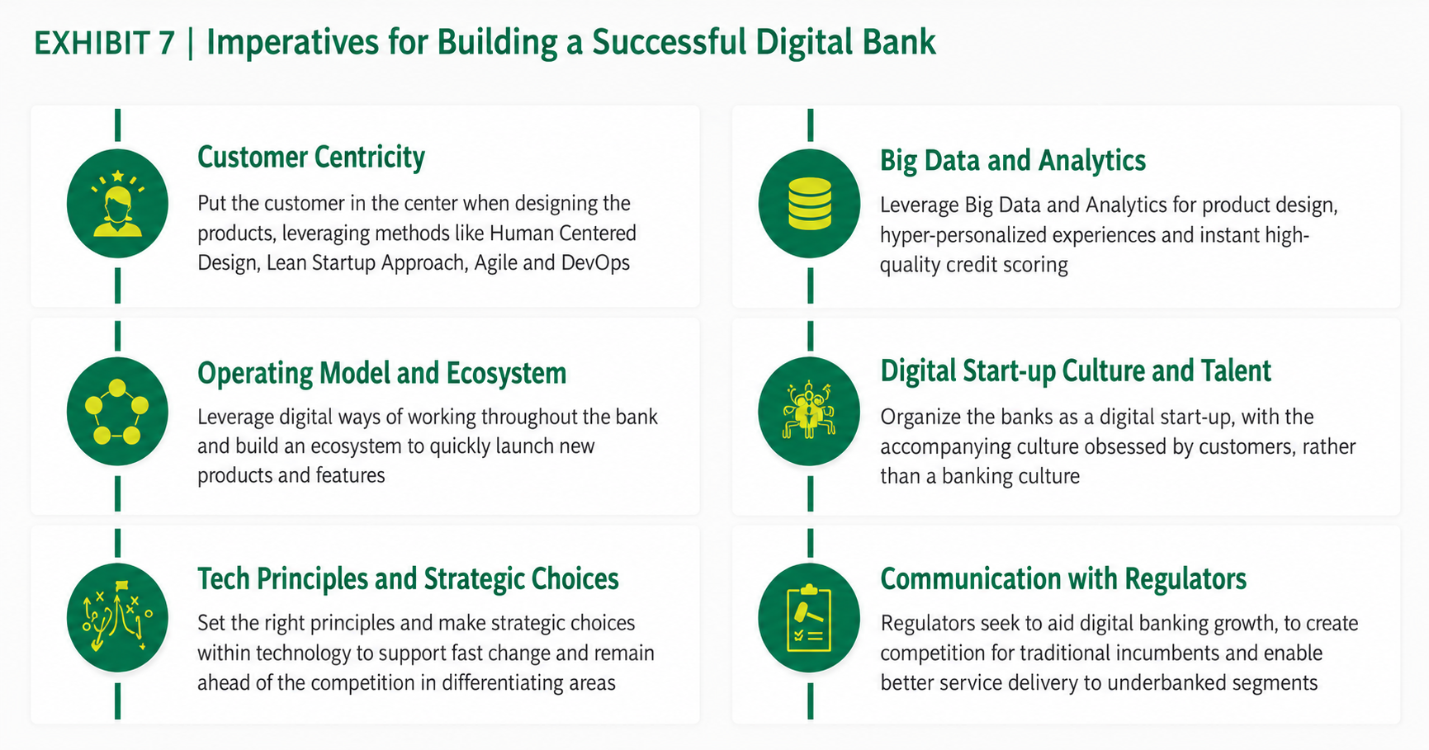
6 Imperatives for Successful Digital-only Bank (Boston Consulting Group)
Notes:
Summary and Closure Slides
Note:
Summarise 3–5 key takeaways
Reinforce main ideas
Indicate CLO coverage where appropriate
Include:
Upcoming topics
Required reading
Tutorial / lab / assessment linkage

Slide 36
DIGITAL-ONLY BANKS
Strategic
Priorites

Slide 37
Financial Technology – Digital-only Banks (Neobanks)
1.1. What Banking Customers Want
A distinction must be made between basic services customers receive and services they want. All customers expect four basic services: transaction management, lending, savings, and financial guidance. What customers want today is a less tangible list of benefits, and simplicity in keeping track of their money is at the top of this list. Banks that make it easy tend to create customer loyalty.
Bankers have always thought that offering more services and opening more branches were the keys to success. However, customers want to be able to keep their complex money matters simple and close at hand.
A survey of 3,250 consumers and 1,350 merchants conducted in Indonesia, Malaysia, Singapore, Thailand and Vietnam found that lack of personalized advice (58%), high fees (45%) and an unattractive image (40%) are the top reasons for consumers to shift from traditional banks in Southeast Asia.
Notes:
Engagement and Activity Slides
Note:
Include at least one engagement element where appropriate:
Think–Pair–Share
Mini task
Poll or reflection question
Suggested duration: 3–5 minutes
Activities shall align with learning outcomes

Slide 38
What Banking Customers Want
Data is the foundation for personalized intelligence, with advanced analytics on transaction, customer, and other data types allowing digital banks to build understanding of customer desires and expectations. Features can be adapted to deliver personalized services based on this data, ensuring that customers are served with hyper-relevant content, products, and offers
A data-driven platform then offers a personalized user experience, with intuitive interface that provide both positive engagement and simple ease of use, alongside an adaptive approach that builds insight from data.
Notes:
Summary and Closure Slides
Note:
Summarise 3–5 key takeaways
Reinforce main ideas
Indicate CLO coverage where appropriate
Include:
Upcoming topics
Required reading
Tutorial / lab / assessment linkage

Slide 39
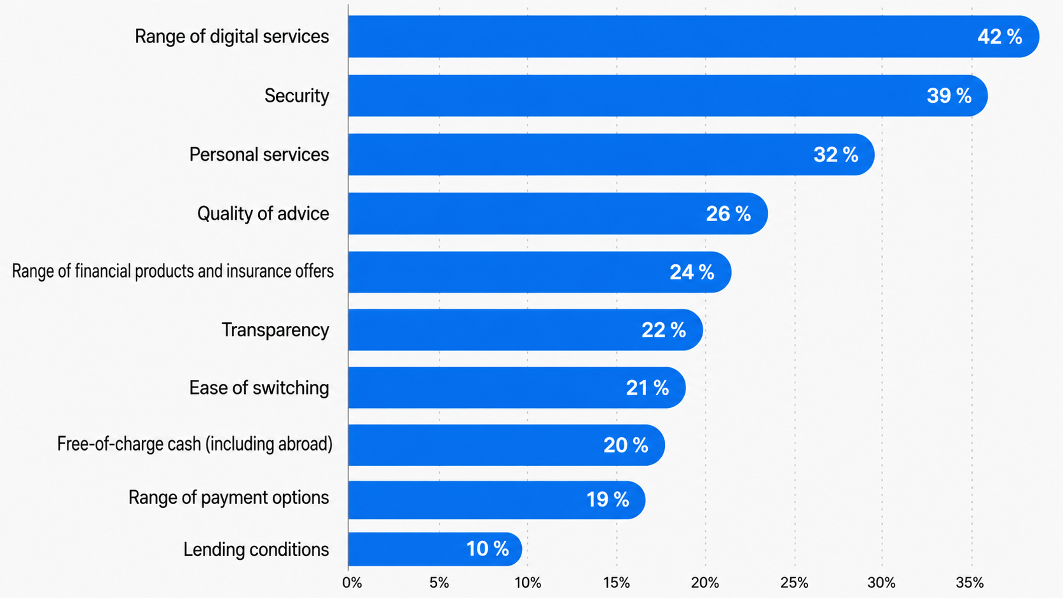
Digital-only Banks Benefits (according to users)
Notes:
Summary and Closure Slides
Note:
Summarise 3–5 key takeaways
Reinforce main ideas
Indicate CLO coverage where appropriate
Include:
Upcoming topics
Required reading
Tutorial / lab / assessment linkage

Slide 40
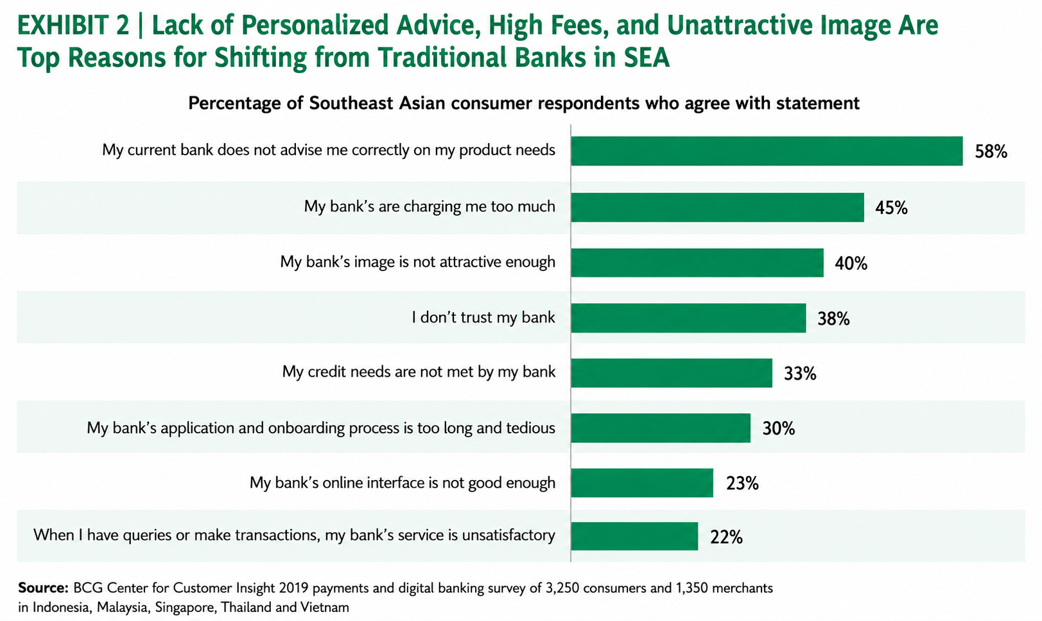
What Banking Customers Want.
Notes:
Summary and Closure Slides
Note:
Summarise 3–5 key takeaways
Reinforce main ideas
Indicate CLO coverage where appropriate
Include:
Upcoming topics
Required reading
Tutorial / lab / assessment linkage

Slide 41
Financial Technology – Digital-only Banks (Neobanks)
1.1. Digital-only Banks – Strategic Priorities
Attract customers:
As these banks are still in their infancy, they face very low levels of consumer awareness
These banks recognize the importance of building functionally rich propositions. Given that the main high street banks have their own digital capabilities, the digital-only banks must prove their offer is sophisticated enough for customers to start using their products. Critically, the proposition must be more than a better app.
Leveraging community will also be critical for these banks as they aim to capitalize on the compelling benefits of the network effect of satisfying users in the social media age.
Notes:
Engagement and Activity Slides
Note:
Include at least one engagement element where appropriate:
Think–Pair–Share
Mini task
Poll or reflection question
Suggested duration: 3–5 minutes
Activities shall align with learning outcomes

Slide 42
Financial Technology – Digital-only Banks (Neobanks)
1.1. Digital-only Banks – Strategic Priorities
Differentiate from the other digital players and the high street banks who are digitizing fast:
A steady stream of new digital-only banks are entering the market, most of which are perceived as offering similar, if not identical services.
Without clear differentiation, it will be difficult for any single bank to corner enough of the (still limited) market of customers seeking digital-only propositions.
Notes:
Engagement and Activity Slides
Note:
Include at least one engagement element where appropriate:
Think–Pair–Share
Mini task
Poll or reflection question
Suggested duration: 3–5 minutes
Activities shall align with learning outcomes

Slide 43
Financial Technology – Digital-only Banks (Neobanks)
1.1. Digital-only Banks – Strategic Priorities
Expand profitably:
While the digital-only banks have low cost bases, profitability is tough given small customer numbers; all the more so, since their customers tend to be younger, multi-banked and, for the time being, less financially mature.
Investors in digital-only banks understand that these ventures won’t turn a profit overnight, but pressure will mount.
The flexibility and location independence of their business models mean these banks are able to consider expansion into other geographies – provided customer needs are sufficiently similar and they can obtain local regulatory approvals.
Notes:
Engagement and Activity Slides
Note:
Include at least one engagement element where appropriate:
Think–Pair–Share
Mini task
Poll or reflection question
Suggested duration: 3–5 minutes
Activities shall align with learning outcomes

Slide 44
Digital-only Banks – Strategic Priorities
One of the ways neobanks have been able to attract customers is through the promise of lower fees. Because they do not have to pay the costs of running physical branches, they are able to offer services for free that more established institutions charge for, such as withdrawing money in a foreign currency. However, while neobanks are low-cost, they are also low-earning.
“Profitability is an issue, because these banks are offering their services below cost to attract new members,” “This is especially true if they are doing no-fee and no-mark-up international money transfers.
The profit problem is perhaps best exemplified by the fact that earlier this year (2018), Revolut claimed the distinction of being the first challenger bank to break even on a monthly basis. Revolut CEO Nik Storonsky said that his fintech has been profitable since 2021.
UK digital-only bank Monzo experienced record revenue growth in 2022, setting it on course to achieve annual profitability by the end of 2023. Annualised revenues shot up 250% to £440m in the twelve months to December 2022.
Notes:
Summary and Closure Slides
Note:
Summarise 3–5 key takeaways
Reinforce main ideas
Indicate CLO coverage where appropriate
Include:
Upcoming topics
Required reading
Tutorial / lab / assessment linkage

Slide 45
Digital-only Banks – Strategic Priorities
Starling became the first European neobank to hit annual profitability in July 2022, after revenue grew 93% thanks to a surge in lending.
Neobanks need to pivot their strategies to adapt and focus on generating profits in a harsher-looking H2 2022 / 2023. Venture capitalists are pressuring their portfolio companies to push toward profitability as the economic outlook becomes more uncertain. Berlin-based N26 has been refocusing its resources on core European markets after high-profile exits from the U.S. and U.K.
Lower costs: Varo is finding out the hard way that high overhead costs that exceed revenues aren’t sustainable. One problem is that customer acquisition costs have generally risen for neobanks due to incumbents improving their digital offerings, and the market has become more saturated.
Shift to more profitable products: Focusing on higher-profit products and dropping less lucrative ones will be important as newer entrants’ strategies shift away from merely attracting customers. Starling’s decision to focus on software as a service (SaaS) and mortgage lending, rather than European expansion, is one example of this kind of pivot.
Notes:
Summary and Closure Slides
Note:
Summarise 3–5 key takeaways
Reinforce main ideas
Indicate CLO coverage where appropriate
Include:
Upcoming topics
Required reading
Tutorial / lab / assessment linkage

Slide 46
Digital-only Banks – Strategic Priorities
Expanding features for paid tiers: Challenger banks can use new features to draw in paying customers. Monese has aimed to achieve this through its Essential tier, which charges lower fees for international transfers and foreign exchange conversions.
If securities income is excluded, neobanks’ margin advantage fades. Overall, neobank returns appear weak, with only a few neobanks generating profits.
Overall, emerging market neobanks tend to fare better than advanced economy neobanks. Emerging market neobanks display relatively lower liquidity risk than advanced economy neobanks with a stronger revenue profile and wider loan and fee margins. This seems to be related to life cycle factors (in light of the larger portion of “mature” neobanks in the emerging market subsample), but also to business models (given the relatively strong performance of Chinese neobanks).
Notes:
Summary and Closure Slides
Note:
Summarise 3–5 key takeaways
Reinforce main ideas
Indicate CLO coverage where appropriate
Include:
Upcoming topics
Required reading
Tutorial / lab / assessment linkage

Slide 47
Digital-only Banks – Strategic Priorities
The leaner funding climate favors more established companies and increases pressure on far-from-profitable neobanks, which may lose investors who question their long-term sustainability. If a neobank shakeout occurs in the coming years, the banks that can adapt to remain profitable are the ones that stand to survive
Notes:
Summary and Closure Slides
Note:
Summarise 3–5 key takeaways
Reinforce main ideas
Indicate CLO coverage where appropriate
Include:
Upcoming topics
Required reading
Tutorial / lab / assessment linkage

Slide 48
Digital-only Banks – Strategic Priorities
1.1. Strategic Partnerships
Alternatively, neobanks can partner with financial firms that already possess regulatory approval in order to launch their products. This approach is not only quicker, it also grants them access to market and customer data that can be used to attract new clients.
Digital bank Revolut offers an example of an emerging digital bank driving growth through this proposition. Commission-free FX helped simplify travel and address an unmet need. Simple and fast on-boarding and free accounts were designed for frictionless user experience. Unique card branding and innovative cryptocurrency exchange offers a unique attraction for customers. An online community and daily banking needs added that element of interaction.
Notes:
Engagement and Activity Slides
Note:
Include at least one engagement element where appropriate:
Think–Pair–Share
Mini task
Poll or reflection question
Suggested duration: 3–5 minutes
Activities shall align with learning outcomes

Slide 49
Digital-only Banks – Strategic Priorities
KakaoBank and TMRW showcase two other digital banks employing customer experience as an important differentiator. Both banks seek to leverage the idea of customer obsession and engagement as a model to drive adoption.
KakaoBank’s Eat Lover Club and shared social payment account allows members to easily share and track funds, while also offering quirky reminder messages for outstanding transfers. TMRW utilizes PFM tools and smart savings, alongside a 24-hour chatbot, to ensure frictionless and customer focused functionality.
Efforts to digitize banking services continue to grow, with the gap between retail banks and digital banks narrowing. The biggest differences remain in the functions offered and the customer experience, where neobanks stand out through innovation and their primarily digital customer relationships.
Retail banks are catching up with digital banks and their hybrid services. Revolut remains unbeatable, according to the study authors with special functions such as time-limited bank cards and instant payments
Notes:
Summary and Closure Slides
Note:
Summarise 3–5 key takeaways
Reinforce main ideas
Indicate CLO coverage where appropriate
Include:
Upcoming topics
Required reading
Tutorial / lab / assessment linkage

Slide 50
Digital-only Banks – Strategic Priorities
1.1. Social Networks
When it comes to social networks, 58 percent of the banks surveyed use Linkedin, while only 20 percent have an active Tik Tok account. Apparently, the aim is to appeal to professionals in a serious setting rather than to younger people in an unconventional setting.
Another difference is in the content disseminated. Where traditional banks emphasize their ESG (environmental, social and governance) products and CSR (corporate social responsibility) commitment, neo-banks are more likely to talk about new technologies and cryptocurrencies.
Notes:
Engagement and Activity Slides
Note:
Include at least one engagement element where appropriate:
Think–Pair–Share
Mini task
Poll or reflection question
Suggested duration: 3–5 minutes
Activities shall align with learning outcomes

Slide 51
INTRODUCTION TO FINTECH
Issues
&
Challenges

Slide 52
Financial Technology – Digital-only Banks (Neobanks)
1.1. Risks and Challenges
Digital banking is an exciting and valuable emerging opportunity, but it is not without its risks.
Consumer protection is perhaps the most prominent of these challenges, particularly in light of the rapid evolution of the landscape.
Financial regulations on fintech players tend to be less restrictive than on the heavily regulated established institutions. Many founders come from non-banking backgrounds, and may not fully understand the market risks. Fintech customers also disproportionately belong to previously unbanked segments, where financial literacy tends to be lower. This can mean they are less informed on how to independently negotiate risks.
Notes:
Engagement and Activity Slides
Note:
Include at least one engagement element where appropriate:
Think–Pair–Share
Mini task
Poll or reflection question
Suggested duration: 3–5 minutes
Activities shall align with learning outcomes

Slide 53
Risks and Challenges
Cybersecurity breaches present an inflated risk to these tech-heavy offerings, with significant potential disruption from successful attacks.
Data protection is also a major concern, with multiple consumer data points and large volumes of data used for service personalization. This raises questions of appropriate and secure data storage and usage. The potential for long-term value erosion in a competitive market presents a further risk.
Many digital banking players are competing on price, potentially triggering a race to the bottom style approach which leads to large scale value erosion in banking markets. This value erosion feeds into a larger point around business sustainability.
Digital banks focus on building scale through customer acquisition. Profitability is typically achieved only after 5-7 years of operations. Business sustainability is not guaranteed, and there are as of yet limited successful examples in the Asia region. Many players are oriented to success metrics based on achieving higher valuations or greater volume of app downloads, which may not necessarily transition into financial sustainability.
Notes:
Summary and Closure Slides
Note:
Summarise 3–5 key takeaways
Reinforce main ideas
Indicate CLO coverage where appropriate
Include:
Upcoming topics
Required reading
Tutorial / lab / assessment linkage

Slide 54
Risks and Challenges
Profitability remains a real hurdle for these emerging digital players. Of the 10 top Digital Challenger Banks globally by user base, just five have achieved profitability.
The key drivers to profitability are a combination of fee-based and interest-based revenue streams, together with a lower cost structure due to their app-centric approach. This ensures lower operational costs due to elimination of manual processing steps, and reduced customer communication commitments. The absence of costly legacy IT infrastructure and branchless setup are also important differentiators.
Notes:
Summary and Closure Slides
Note:
Summarise 3–5 key takeaways
Reinforce main ideas
Indicate CLO coverage where appropriate
Include:
Upcoming topics
Required reading
Tutorial / lab / assessment linkage

Slide 55
Financial Technology – Digital-only Banks (Neobanks)
1.1. The Digital Age Demands a Digital-only Bank
Now here’s the challenge. The bank cannot leverage data; it’s locked in product silos. It cannot serve the customer’s needs. Banks layered channels over products. Now, they need to leverage data over mobile. And banks lost the end-to-end process as customers moved to apps and pieces of process and functionality as needed
Now there’s a need to organise the bank around the customer’s data and then leverage that data through the cloud to mobile devices as apps
Notes:
Engagement and Activity Slides
Note:
Include at least one engagement element where appropriate:
Think–Pair–Share
Mini task
Poll or reflection question
Suggested duration: 3–5 minutes
Activities shall align with learning outcomes

Slide 56
Financial Technology – Digital-only Banks (Neobanks)
1.1. SMEs and Fintech
SMEs have become significant users of Fintech globally. The most popular banking services used are …
banking and payments
financial management
financing (loans)
Insurance
There haven't been any other great alternatives for SMEs in the past. And doing something different meant more work with time they didn’t have
Notes:
Engagement and Activity Slides
Note:
Include at least one engagement element where appropriate:
Think–Pair–Share
Mini task
Poll or reflection question
Suggested duration: 3–5 minutes
Activities shall align with learning outcomes

Slide 57
SMEs and Fintech
That’s starting to change as FinTechs enable a digital, mobile-first experience that simplifies access to the business banking services needed for these SMEs to run their businesses.
And importantly, they’re using data and technology to give SMEs access to the one thing they really want: working capital when they need it. These FinTechs bundle business applications into a single platform, making it easy for them to turn features on an off as needed
These platforms are raising the expectations of what SMEs now expect from their business banking relationship
Notes:
Summary and Closure Slides
Note:
Summarise 3–5 key takeaways
Reinforce main ideas
Indicate CLO coverage where appropriate
Include:
Upcoming topics
Required reading
Tutorial / lab / assessment linkage

Slide 58
DIGITAL-ONLY BANKS
Popular
Digital-Only
Banks

Slide 59
Financial Technology – Digital-only Banks (Neobanks)
1.1. Case Study - Malaysia
Malaysia’s central bank is set to issue up to five digital banking licenses to qualified applicants looking to conduct either conventional or Islamic banking businesses in the country. BNM said that it looks to take a balanced approach to enable the admission of digital banks with strong value propositions while securing the stability of the financial system.
BNM also requires digital banks to maintain minimum capital funds, unimpaired by losses, of 100 million ringgit (US$24.2 million) and 300 million ringgit (US$72.6 million) thereafter.
Notes:
Engagement and Activity Slides
Note:
Include at least one engagement element where appropriate:
Think–Pair–Share
Mini task
Poll or reflection question
Suggested duration: 3–5 minutes
Activities shall align with learning outcomes

Slide 60
Digital-only Banks – Case Study : Singapore
1.1. Digital-only Banking @ Malaysia
Compared to Singapore and Hong Kong, Malaysia has ensured that new digital banks are able to access ATM networks and cheque infrastructure, acknowledging that some parts of the economy with unmet and unserved needs will still need access to these while using digital banks.
Malaysia clearly expressed a preference for local equity control to end debates about headquarter location, management, and operating and board control.
Notes:
Engagement and Activity Slides
Note:
Include at least one engagement element where appropriate:
Think–Pair–Share
Mini task
Poll or reflection question
Suggested duration: 3–5 minutes
Activities shall align with learning outcomes

Slide 61
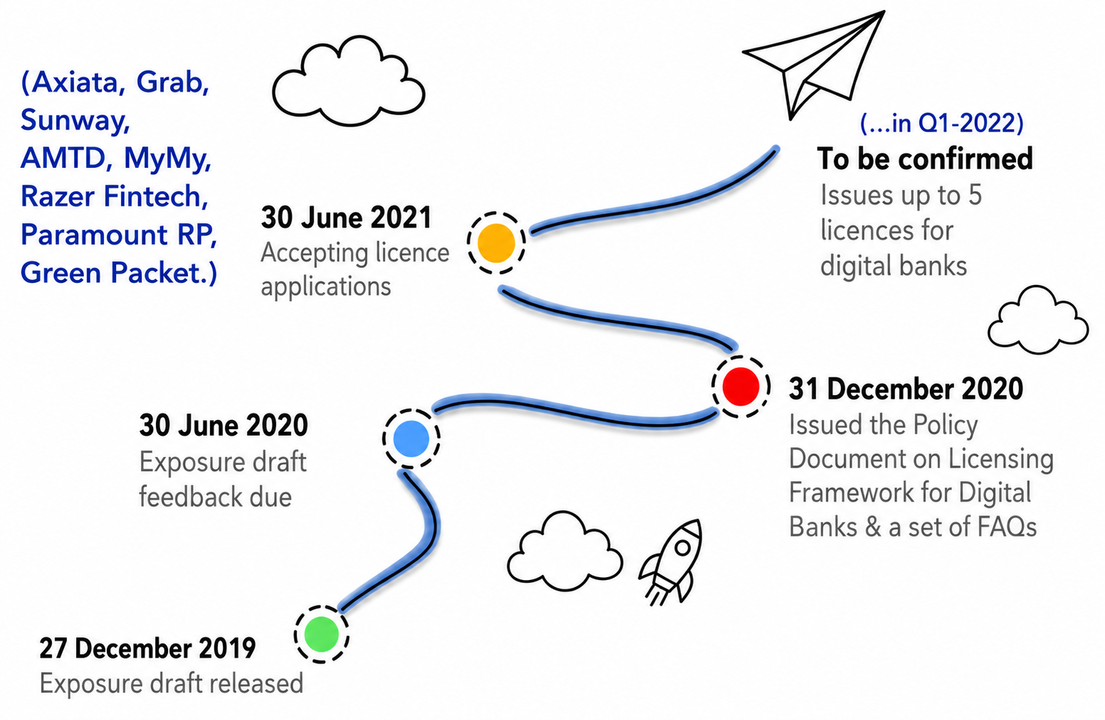
SMEs and Fintech
Notes:
Summary and Closure Slides
Note:
Summarise 3–5 key takeaways
Reinforce main ideas
Indicate CLO coverage where appropriate
Include:
Upcoming topics
Required reading
Tutorial / lab / assessment linkage

Slide 62
Financial Technology – Digital-only Banks (Neobanks)
1.1. Digital-only Banks in 2022
A total of 43 new challenger banks have entered the global marketplace in 2022. This is in spite of the world wide economic downturn triggered by the pandemic and international conflict. This rise is a 17.11% increase on new market entrants in 2021 - a year generally heralded as being a boomtime for fintechs as digital transformation saw massive investment in the space.
In 2021, there were 248 challenger banks globally. Today, at the close of Q4 2022, there are now 291
Notes:
Engagement and Activity Slides
Note:
Include at least one engagement element where appropriate:
Think–Pair–Share
Mini task
Poll or reflection question
Suggested duration: 3–5 minutes
Activities shall align with learning outcomes

Slide 63
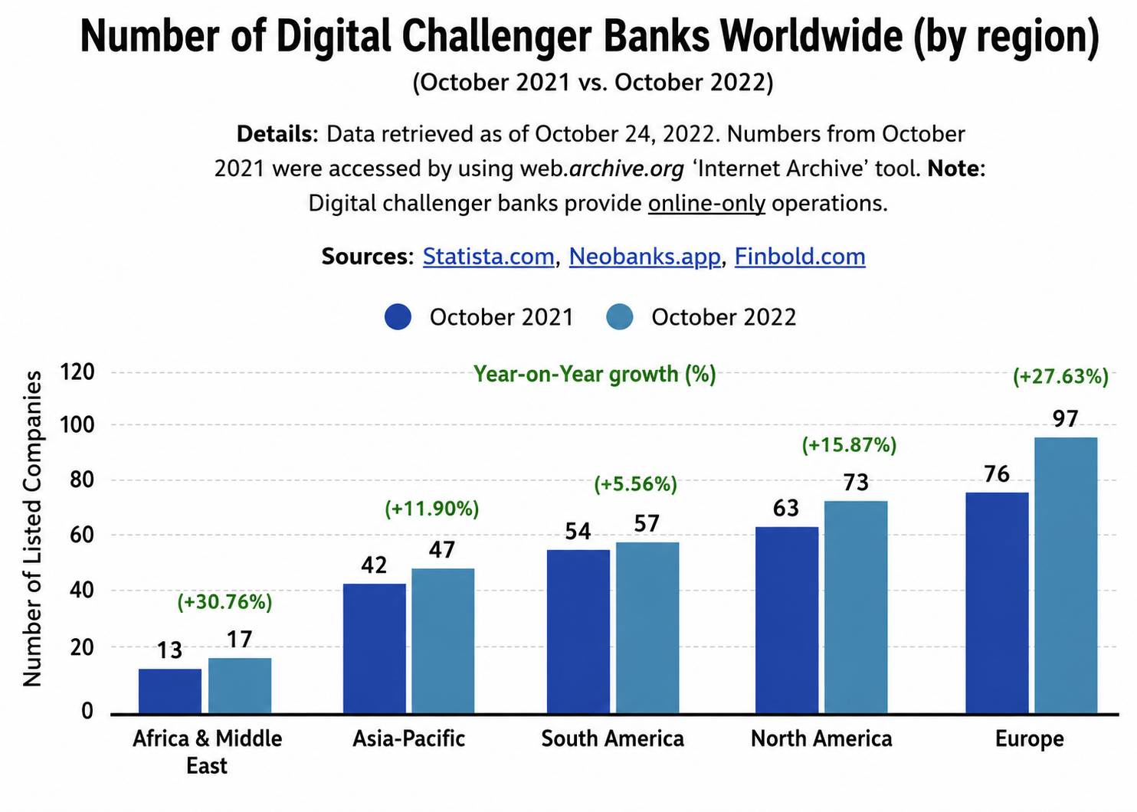
Digital-only Banks in 2022
Notes:
Summary and Closure Slides
Note:
Summarise 3–5 key takeaways
Reinforce main ideas
Indicate CLO coverage where appropriate
Include:
Upcoming topics
Required reading
Tutorial / lab / assessment linkage

Slide 64
DIGITAL-ONLY BANKS
Strategies
For
Incumbents

Slide 65
Financial Technology – Digital-only Banks (Neobanks)
1.1. Strategies for Incumbents
A bank strategy today needs to start around a digitally enabled bank.
The bank would be based on digitised techniques of customer understanding in order to build processes from the customer viewpoint.
In recent years, several incumbents have decided to establish stand-alone digital-only banking units under separate brands to tackle competition from neobanks and satisfy demand from digitally active customers.
Notes:
Engagement and Activity Slides
Note:
Include at least one engagement element where appropriate:
Think–Pair–Share
Mini task
Poll or reflection question
Suggested duration: 3–5 minutes
Activities shall align with learning outcomes

Slide 66
Financial Technology – Digital-only Banks (Neobanks)
1.1. Strategies for Incumbents #1
Acquiring already existing neobanks can also turn out to be a bumpy road for traditional banks. French incumbent BPCE bought German digital-only player Fidor in 2016 and only two years later, it is reportedly seeking to sell it because of a “clash of cultures”
In another example, US neobank Simple had difficulties moving customer accounts to a new platform after being bought by Spanish incumbent BBVA in 2014. The buyer also took hefty write-downs for Simple after its $117 million acquisition
Notes:
Engagement and Activity Slides
Note:
Include at least one engagement element where appropriate:
Think–Pair–Share
Mini task
Poll or reflection question
Suggested duration: 3–5 minutes
Activities shall align with learning outcomes

Slide 67
Financial Technology – Digital-only Banks (Neobanks)
1.1. Strategies for Incumbents #1
Acquisitions
Acquiring and investing in existing tech assets to build up digital reach and digital capabilities. BBVA utilized this strategy by acquiring Simple in 2014 for USD117 million, going on to invest in a 39% stake in UK-based Atom Bank in 2015. In 2016 they acquired Finnish bank Holvi, and invested in German SolarisBank in 2018.
Traditional banks setting up a neobank should consider building a new infrastructure for the “parallel bank” and using it as a sandbox to learn how to run a truly digital organization
They shouldn’t rush into integrating the new and old units, as the opportunities to experiment disappear with a merger. Also, building a neobank shouldn’t preclude the original organisation from carrying out its own digital transformation.
Notes:
Engagement and Activity Slides
Note:
Include at least one engagement element where appropriate:
Think–Pair–Share
Mini task
Poll or reflection question
Suggested duration: 3–5 minutes
Activities shall align with learning outcomes

Slide 68
Financial Technology – Digital-only Banks (Neobanks)
1.1. Strategy (Incumbents Setting Up Neobanks)
There are 2 different approaches incumbent banks can take to developing a parallel brand…There are 2 different approaches incumbent banks can take to developing a parallel brand…
An approach that relies on bank’s IT infrastructure
Involves creating a new digital organization from the ground up
Banks can view a parallel brand as no more than a new brand attached to the parent institution → the parallel bank is simply an extension of the original organization → relying on the same legacy technology infrastructure → same institution wrapped in a new marketing strategy aimed at younger customers who don’t frequent branches.
Notes:
Engagement and Activity Slides
Note:
Include at least one engagement element where appropriate:
Think–Pair–Share
Mini task
Poll or reflection question
Suggested duration: 3–5 minutes
Activities shall align with learning outcomes

Slide 69
Financial Technology – Digital-only Banks (Neobanks)
1.1. Strategy #2 (Incumbents Setting Up Neobanks)
The second approach → treat the parallel bank as a completely new kind of organization → free from the constraints that have hampered legacy banks’ effort at digital transformation → it is a sandbox that allows the parent institution to learn how to build and operate a truly digital organization.
Taking this approach → need to build a new technology infrastructure that supports the parallel bank’s ability to integrate new technologies and partners → iterates quickly on new products and services.
Notes:
Engagement and Activity Slides
Note:
Include at least one engagement element where appropriate:
Think–Pair–Share
Mini task
Poll or reflection question
Suggested duration: 3–5 minutes
Activities shall align with learning outcomes

Slide 70
Strategy #2 (Incumbents Setting Up Neobanks)
As the parallel bank experiments and grows, the parent organization can gain greater knowledge about …
emerging technologies,
potential startup partners,
new business models,
different organizational structures
Forward-looking recruiting tactics
In-house builds. Leveraging tech providers to power digital capabilities for a new digital bank. Singaporean legacy operator UOB embraced an in-house build to successfully launch its TMRW digital bank in Thailand in 2019. It plans to roll-out across other markets in Southeast Asia in coming years, thanks to the underlying architecture and personalization capabilities powered by tech providers Personetics and Meniga
Notes:
Summary and Closure Slides
Note:
Summarise 3–5 key takeaways
Reinforce main ideas
Indicate CLO coverage where appropriate
Include:
Upcoming topics
Required reading
Tutorial / lab / assessment linkage

Slide 71
Financial Technology – Digital-only Banks (Neobanks)
1.1. Strategy #3 - Partnerships
Partner. Providing banking licenses to create a joint digital bank with technology partner(s). European VPBank partnered with Timo to offer banking license and core banking systems, as well as KYC functionality as part of a revenue sharing agreement. In turn, Timo enabled VPBank to experiment with building a new technology stack, as well as adopting new on-boarding methodologies
Notes:
Engagement and Activity Slides
Note:
Include at least one engagement element where appropriate:
Think–Pair–Share
Mini task
Poll or reflection question
Suggested duration: 3–5 minutes
Activities shall align with learning outcomes

Slide 72
Strategy #3 - Partnerships
Partner. Providing banking licenses to create a joint digital bank with technology partner(s). European VPBank partnered with Timo to offer banking license and core banking systems, as well as KYC functionality as part of a revenue sharing agreement. In turn, Timo enabled VPBank to experiment with building a new technology stack, as well as adopting new on-boarding methodologies
Fintechs bring their innovative mindset, agility, customer centricity and digital infrastructure to the table, while incumbents can help fintechs scale better based on trust and brand recognition, and provide them with a distribution network.
No wonder that half of US bank executives expect fintech
Notes:
Summary and Closure Slides
Note:
Summarise 3–5 key takeaways
Reinforce main ideas
Indicate CLO coverage where appropriate
Include:
Upcoming topics
Required reading
Tutorial / lab / assessment linkage

Slide 73
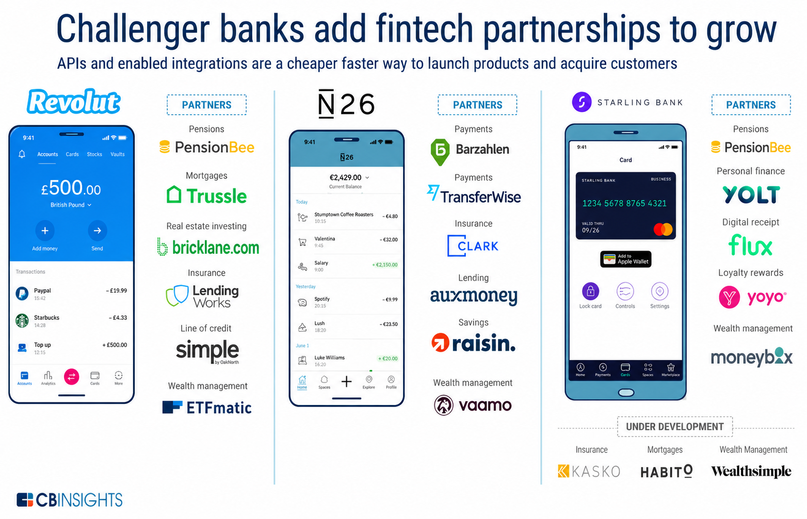
Strategy #3 - Partnerships
Notes:
Summary and Closure Slides
Note:
Summarise 3–5 key takeaways
Reinforce main ideas
Indicate CLO coverage where appropriate
Include:
Upcoming topics
Required reading
Tutorial / lab / assessment linkage

Slide 74
DIGITAL-ONLY BANKS
Regulations

Slide 75
Financial Technology – Digital-only Banks (Neobanks)
1.1. Regulations
The value of agility can only truly be enabled within an appropriate regulatory framework. Digital banks must work with regulators to unlock the full potential of this remarkable opportunity, ensuring that guide rails can steer transformation without limiting innovation
Regulators are seeking to assist digital banking growth, driven by two key imperatives.
The first is to create competition for traditional incumbents, amplifying the need for better and more effective products and services.
The second is the fundamental desire to drive better service delivery to underbanked segments.
Notes:
Engagement and Activity Slides
Note:
Include at least one engagement element where appropriate:
Think–Pair–Share
Mini task
Poll or reflection question
Suggested duration: 3–5 minutes
Activities shall align with learning outcomes

Slide 76
Regulations – Key Factors in Assessing Suitability
The latter is a particular focus in Southeast Asia. Regulators are likely to examine five key factors in assessing the suitability of candidate digital banks:
Regulators are likely to examine five key factors in assessing the suitability of candidate digital banks
Path to profitability
Regulators will wish to see a convincing path towards profitability for candidate digital banks. Many operators have shown impressive user growth, without truly achieving a breakeven which will be fundamental to the sustainable success of digital banking. Many players have unproven business models, showing that innovation still requires recognition of financial demands
Notes:
Summary and Closure Slides
Note:
Summarise 3–5 key takeaways
Reinforce main ideas
Indicate CLO coverage where appropriate
Include:
Upcoming topics
Required reading
Tutorial / lab / assessment linkage

Slide 77
Regulations – Key Factors in Assessing Suitability
Key differentiation
With the priority around reaching underbanked segments foremost in mind, regulators are likely to want to understand what differentiates a digital bank’s proposition, and how unique it is in the marketplace. It is crucial for digital bank candidates to communicate how they are different from incumbents, and how they might employ transparent, robust technology approaches and design to cater to the demands of a customer-centric landscape
Adherence to regulation.
While enabling digital banking opportunity requires freedom to innovative to scale, it must also cater to the underlying need to meet existing banking regulation. That includes those which apply to existing incumbent operators, as well as any evolving regulation which may apply to digital banks
Notes:
Summary and Closure Slides
Note:
Summarise 3–5 key takeaways
Reinforce main ideas
Indicate CLO coverage where appropriate
Include:
Upcoming topics
Required reading
Tutorial / lab / assessment linkage

Slide 78
Regulations – Key Factors in Assessing Suitability
Consumer protection.
Regulators will wish to see how consumer protection will be ensured, cybersecurity risks mitigated, and data protection robustly implemented.
Ability to serve underserved
Regulators are likely to want to understand underbanked and underserved customer segments will be served by proposed digital banks
Notes:
Summary and Closure Slides
Note:
Summarise 3–5 key takeaways
Reinforce main ideas
Indicate CLO coverage where appropriate
Include:
Upcoming topics
Required reading
Tutorial / lab / assessment linkage

Slide 79
DIGITAL-ONLY BANKS
Conclusion

Slide 80
Financial Technology – Bank at Marketplace :
1.1. Conclusion
There is no doubt that neo banks are typically perceived as having better technology that provides better access and better services than the established players.
Neo banks also tend to speak to their customers with greater clarity providing transparency and better incentives or deals. They can also offer faster client onboarding.
Notes:
Engagement and Activity Slides
Note:
Include at least one engagement element where appropriate:
Think–Pair–Share
Mini task
Poll or reflection question
Suggested duration: 3–5 minutes
Activities shall align with learning outcomes

Slide 81
Financial Technology – Bank at Marketplace :
1.1. Digital-only Banks to “rebundle” Services via Open Banking
Who will benefit from this rebundling and from Open banking ?
Digital-only Banks → have more services to offer will make them more compelling.
Fintechs → Gives them more access to users via bank accounts.
Users → increases value proposition by having a digital-only bank account.
Notes:
Engagement and Activity Slides
Note:
Include at least one engagement element where appropriate:
Think–Pair–Share
Mini task
Poll or reflection question
Suggested duration: 3–5 minutes
Activities shall align with learning outcomes

Slide 82
Financial Technology – Bank at Marketplace :
1.1. Future Trend
Challenger banks consolidation begins. Investors are more focused on profitability rather than expansion → funds are slowing down as this sectors reaches another stage of its maturity/growth.
Discuss → “Should we have built trading and crypto instead of launching in the US? In hindsight, it might have been a smart idea”, N26 co-founder and co-chief executive Max Tayenthal told the Financial Times in an interview
Fintech/Tech firms expanding into the banking sector by acquisitions of digital-only banks for their banking licenses.
(eg. June 2020. Credit Sesame (US) acquires Canadian digital-only bank, STACK). (Eg. July 2020. Opera (the web browser) acquiring challenger bank, Fjord Bank).
Notes:
Engagement and Activity Slides
Note:
Include at least one engagement element where appropriate:
Think–Pair–Share
Mini task
Poll or reflection question
Suggested duration: 3–5 minutes
Activities shall align with learning outcomes

Slide 83
Financial Technology – Bank at Marketplace :
1.1. Conclusion
Neobanks are best placed to gain from the current economic climate and individual failings of specific traditional institutions and some of the cryptocurrency providers. Slowly gaining customer awareness, trust and use in recent years, large and SME-sized neobanks have demonstrated their robust security, accessibility, and attention to detail when it comes to servicing customer demands.
Popular with younger demographics, if banks continue to experience issues wider demographics will likely start considering a neo-bank account.
Notes:
Engagement and Activity Slides
Note:
Include at least one engagement element where appropriate:
Think–Pair–Share
Mini task
Poll or reflection question
Suggested duration: 3–5 minutes
Activities shall align with learning outcomes

Slide 84
Conclusion – Disruptive Innovation
In 2023, Lenders have to manage three big tailwinds in today’s market:
Rising delinquency rates and charge-offs.
Higher cost of capital for the debt they lend.
Decreasing demand from customers because of higher interest rates
Do not settle for incremental improvement ,,, go for disruption. Building a solution that makes a task just incrementally easier, or embedding financial services into an existing app, doesn’t generate impactful change for users or the market. Fintech needs companies that will redefine finance.
For example, Klarna and Affirm redesigned and redefined point-of-sale financing with buy-now-pay-later (BNPL). BNPL presents consumers with an entirely new way to think about financing purchases (closed-end installment loans as opposed to open-ended credit with traditional credit cards). BNPL also allows merchants to incentivize specific product purchases with interest-free financing (which the merchant can subsidize), something not
Notes:
Summary and Closure Slides
Note:
Summarise 3–5 key takeaways
Reinforce main ideas
Indicate CLO coverage where appropriate
Include:
Upcoming topics
Required reading
Tutorial / lab / assessment linkage

Slide 85
Conclusion – Disruptive Innovation
Disruptive innovation is welcome in other areas of finance, too. For example, banks are extremely conservative when it comes to offering lines of credit for small businesses, as monitoring can become operationally straining for the bank and thus less appealing for smaller, less-lucrative lines.
It is easy to anchor your product to what others are doing or to pursue incremental innovation. Looking at the many neobanks cropping up, many look the same. Disruptive innovation will always be a challenge, and those players that dare to fully redefine the $800 billion banking market are the ones who will succeed the same way Apple did with consumer technology. Those limiting themselves to merely beating out incumbents will either pivot or fizzle out.
Notes:
Summary and Closure Slides
Note:
Summarise 3–5 key takeaways
Reinforce main ideas
Indicate CLO coverage where appropriate
Include:
Upcoming topics
Required reading
Tutorial / lab / assessment linkage

Slide 86
Conclusion – Adding Value
Do not build superfluous features instead of adding value.
To provide value for your segment, consider your task and focus on doing it well. While the number of your features will be continuously growing, success is rarely measured by their quantity. …quality beats quantity any day of the week.
There are fintechs that focus on sheer feature velocity or build things that just look “cool” versus thinking critically about their customers’ needs and how to add value to their everyday lives. Some fintechs boast a vast number of third-party integrations for their users, but in reality, many of these external services are rarely used by their target segment.
Notes:
Summary and Closure Slides
Note:
Summarise 3–5 key takeaways
Reinforce main ideas
Indicate CLO coverage where appropriate
Include:
Upcoming topics
Required reading
Tutorial / lab / assessment linkage

Slide 87
Conclusion – Adding Value
This kind of window dressing is a misallocation of resources that could be better spent improving and iterating your core offering.
Another example: many consumers don’t actually want or need sophisticated financial visualization tools, like cash-flow prediction. But we continue to see these extraneous features in banking apps because, again, they look cool (or sound good to investors). But backend functionality, like fast money movement, should be prioritized instead.
Functionalities should be purposeful, thoughtful and driven by customer needs or feedback. People will find a way to access the services they need, whether it’s within your platform or living elsewhere. There are needs in the market and so many jobs to be done, so question whether a given functionality is your company’s job.
Notes:
Summary and Closure Slides
Note:
Summarise 3–5 key takeaways
Reinforce main ideas
Indicate CLO coverage where appropriate
Include:
Upcoming topics
Required reading
Tutorial / lab / assessment linkage

Slide 88
Conclusion – Live Support
Do not neglect live support in favor of technology.
Digital finance doesn’t mean 100% self-serve. Of course, the model must work and offer efficiencies from being digitally native, but there are many areas – banking being one of them – where live support is vital. Over-reliance on AI-powered chatbots, voice assistants or self-serve online resources is not only poorly received by current users, but does a disservice to the growth of your business.
This goes back to the idea of understanding that your offering is more than a product – it’s excellent to have a resource center for common questions or troubleshooting, for example, but relying solely on that plus email support is a major shortcoming.
Robust customer support services require various avenues of contact – email, phone, SMS, in-app chat assistance – and, importantly, reliable human support. Never needed, always there should be what you’re optimizing for and ultimately what customers appreciate
Notes:
Summary and Closure Slides
Note:
Summarise 3–5 key takeaways
Reinforce main ideas
Indicate CLO coverage where appropriate
Include:
Upcoming topics
Required reading
Tutorial / lab / assessment linkage

Slide 89
SUMMARY
By the end of this session:
Value Proposition: Branchless digital banks have 40-70% lower operating costs than traditional banks. This enables them to offer lower fees, higher interest rates , and rapid, paperless account setup.
Customer Focus: Customers are switching to digital banks for better user experiences. They prefer the simplicity, transparency , and personalized, data-driven insights that neobanks provide.
Profitability Challenge: Achieving sustainable profit is a major hurdle, as many operate at a loss just to acquire customers. To survive, they are shifting focus to higher-margin products like lending and paid subscription tiers.
Incumbent Strategies: Traditional banks are fighting back by building their own standalone digital brands , acquiring existing neobanks , or forming strategic partnerships with fintech companies.
Risks & Regulations: While regulators support digital banks to increase competition and serve underbanked populations , these banks face significant cybersecurity risks and must prove to regulators they have a clear path to profitability.
Notes:
Summary and Closure Slides
Note:
Summarise 3–5 key takeaways
Reinforce main ideas
Indicate CLO coverage where appropriate
Include:
Upcoming topics
Required reading
Tutorial / lab / assessment linkage

Slide 90

THANK YOU
Shuhaida Bt M Shuhidan
DEPARTMENT OF COMPUTING
shuhaida.shuhidan@utp.edu.my
01-03-31

